Slide 1
What is jVM, JRE, JDK

Slide 2
JVM
JVM, i.e., Java Virtual Machine
JVM is the engine that drives the Java code.
Mostly in other Programming Languages, compiler produce code for a particular system but Java compiler produce Bytecode for a Java Virtual Machine.
When we compile a Java program, then bytecode is generated. Bytecode is the source code that can be used to run on any platform.
Bytecode is an intermediary language between Java source and the host system.
It is the medium which compiles Java code to bytecode which gets interpreted on a different machine and hence it makes it Platform/Operating system independent.

Slide 3
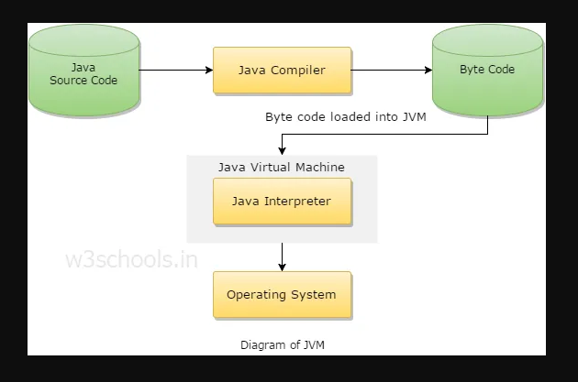

Slide 4
JVM Works like:
1. Reading Bytecode.
2. Verifying bytecode.
3. Linking the code with the library.

Slide 5
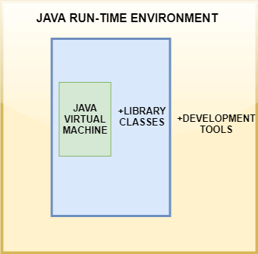
JRE

Slide 6
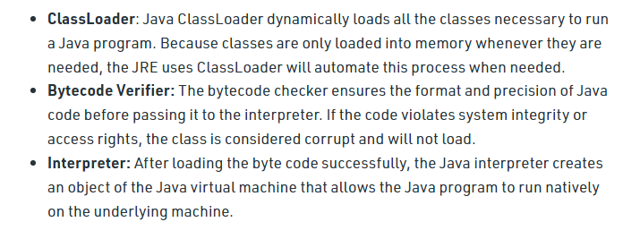
JRE Consist Of:

Slide 7
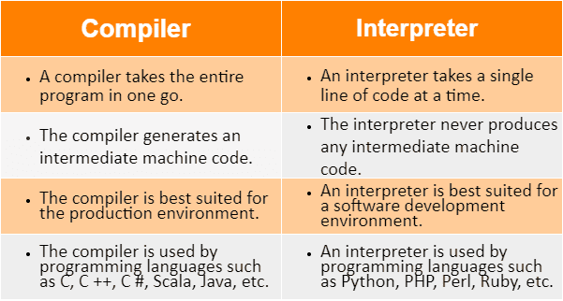
Difference

Slide 8
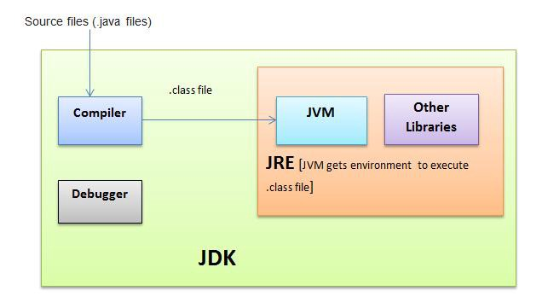
JDK

Slide 9
What is Bytecode
Byte Code can be defined as an intermediate code generated by the compiler after the compilation of source code(JAVA Program). This intermediate code makes Java a platform-independent language.

Slide 10
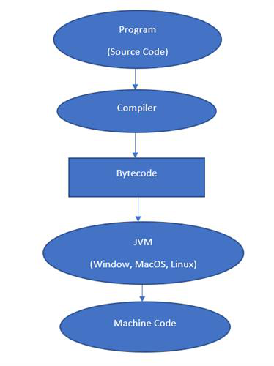
Bytecode
Whenever we write any program, it is not written in machine code. We write it in a high-level language like JAVA, C++, Python, etc. But the computer understands only the machine code. So when we execute our program, it is first converted into machine code or Byte code by the compiler and then executed by the Interpreter.

Slide 11
END

